Slide 1

Book My Doctor Application Development
By:
Surajkhan F Pinjar
Vidya S M
Mamatha Manchala
Susmita Sen

Slide 2
CONTENTS
Introduction
Problem Statement
Objective
Proposed System
Architecture Diagram
Requirement Specification
Implementation
Specific Outcome
Results
Conclusion

Slide 3
1.Introduction
The project is to develop an Online Doctor Appointment Booking System.
This document contains the work flow of the system and gives guidelines on how to build the functionality gradually in each of the course modules.

Slide 4
2.Problem Statement
To develop an application that would help to maintain the records of Online Doctor Appointment Booking System in digital form.
To develop the system that will help people to book an appointment with a doctor and they don’t waste their time to get an appointment .

Slide 5
3.Objective
To remove all the manual work of the patients and receptionist and automate it via web application. This will create a platform for patients which they can see the availability of the doctor and book a doctor for an appointment very easily via web app.

Slide 6
4.Proposed System
The book my doctor application will enable communication between doctors and patients, management of patients’ prescription and management of doctors’ day to day appointments.

Slide 7
5.Architecture
Get All Users
Users
Delete Users
Change Password
Get All Doctor
Doctors
Patient
Get All Patient
Appointments
login
Ratings
View Ratings
History
to “user ” table
View History
View Appointments
Admin
Delete History
Approve Appointments
Book My Doctor Application
Sign up
Profile
Doctor
login
Update Profile
Appointments
Patient
View Appointments
change Password
login
Approve/Reject Appointments
Sign up
Profile
to “user ” table
Search Doctor
Update Profile
View Doctor
change Password
Request Appointment
Add Ratings

Slide 8
Front-End
Back End
HTML Page
Type Script
Service
Back-End
(Presentation Layer)
(Business Logic Layer)
(Data Base Layer)
I
I
Front End
C
C
C
Controller
Services
Data Access Object
(DAO)
My Sql

Slide 9
6.Requirement Specification
1.Angular 8.x
2.Springboot 2.2.2
3.Hibernate with JPA 5.x
4.DataBase MySQL 5.5

Slide 10
7.Implementation
7.1. Modules:
7.1.1 Admin:
Admin has overall control of the system. The main features of admin module are given below.
Manage appointments .
Manage Patient.
Manage doctors.
View Appointments statistics.
Rating Details.

Slide 11
7.1.2 Doctor :
View Appointments.
Manage appointments .
Can schedule their availability dates and the day they are on vacation
7.1.3 Patient:
Can choose and book an appointment at the flexible time and date .
Can search for doctor according to specialty and location .
Can write review about the doctor and can select doctors according to other user feedback .

Slide 12
8.Specific Outcome
Writing a simple HTML code, Opening in explorer to get the output.
Linking CSS, HTML, properties for enhancing the User Interface.
Build Web Pages, Links and URLs.
Working with Forms, Form Data, Building forms, Detection from submission, Single page form processing, Validating form values.
Creating a database, tables in MySQL.
Connect MySQL with Web Pages, Retrieving data from MySQL.
Access MySQL, Working with retrieved data.

Slide 13
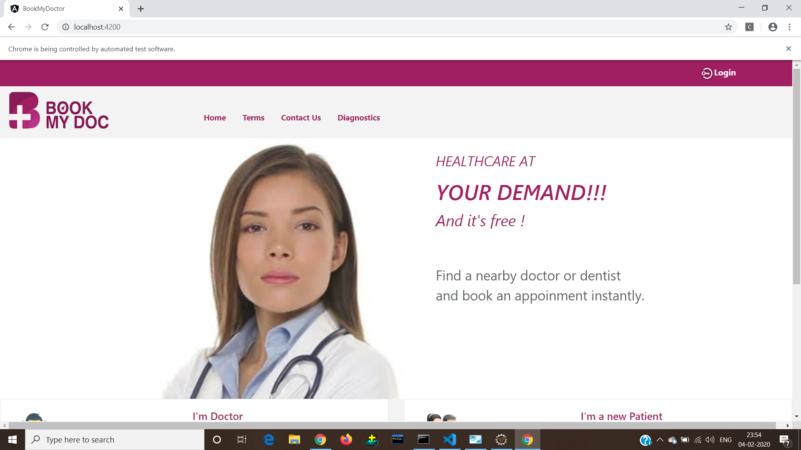
9.Results

Slide 14
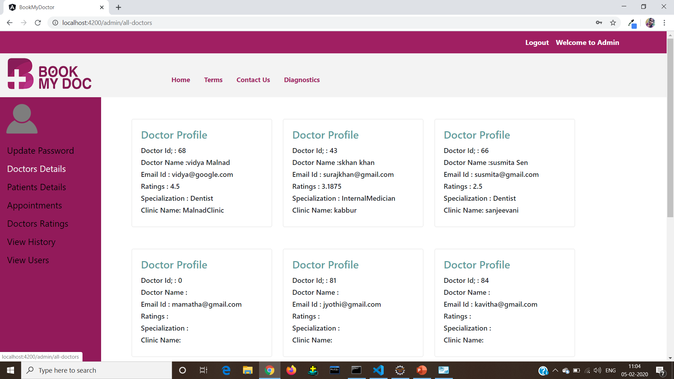
9.Admin

Slide 15
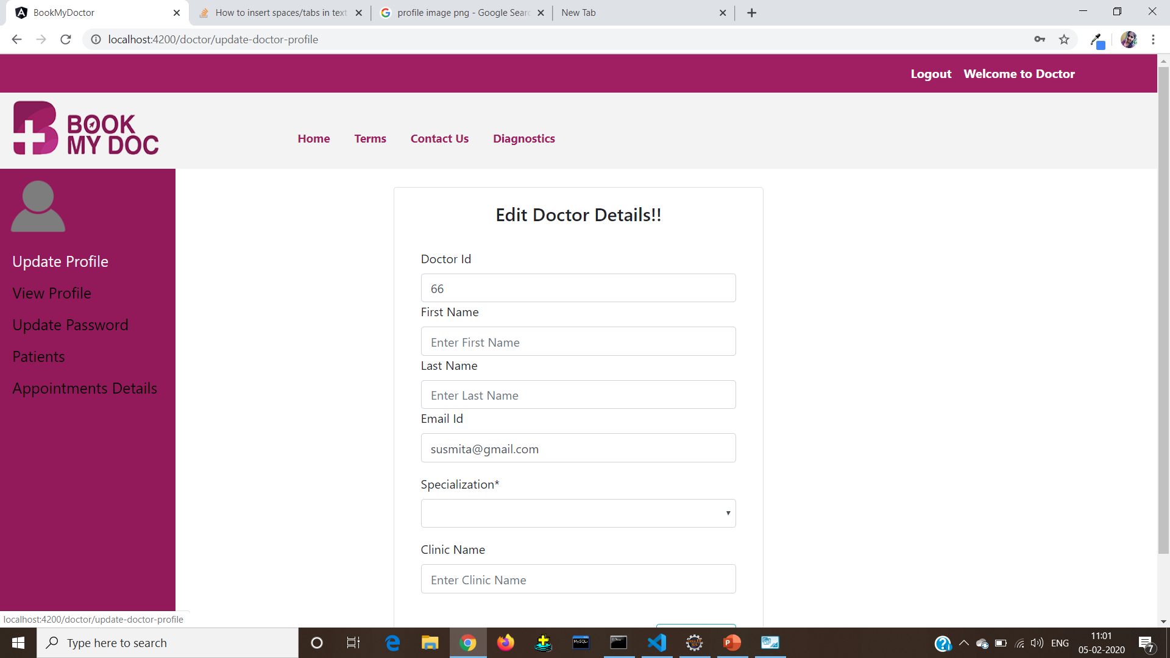
9.Doctor

Slide 16
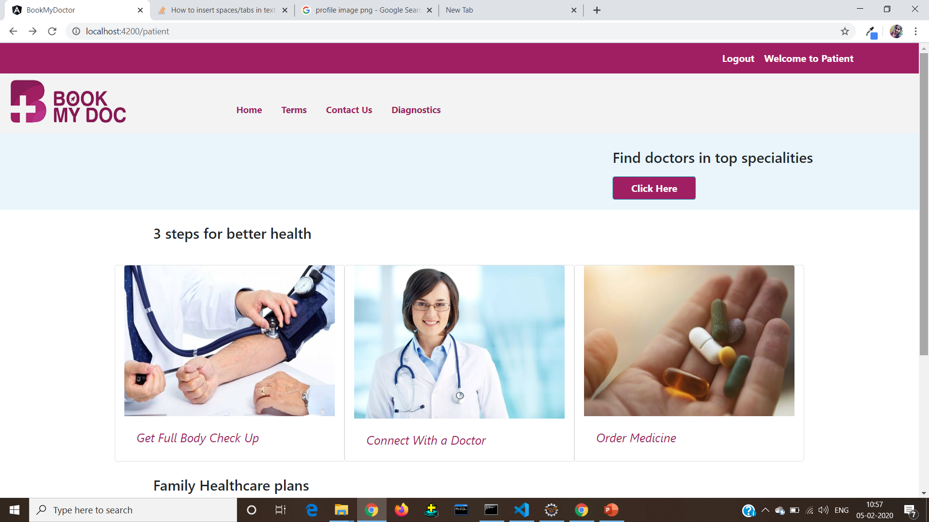
9.Patient

Slide 17
Thank You

